Slide 1
Motion
Chapter 7.1
Page 206 - 215

Slide 2
VECTORS
H
A
V
E
MAGNITUDE
A
N
D
D
I
R
E
C
T
I
O
N
Vector quantities are those that can only be fully described by specifying a direction as well as a magnitude. Force, displacement, velocity and acceleration are all examples of vector quantities.

Slide 3
SCALARS
HAVE
MAGNITUDE
ONLY
Scalar quantities are those that can be described without specifying a direction. Mass, energy, time and temperature are all examples of scalar quantities.

Slide 4
SCALARS
VECTORS

Slide 5
Example 7.1a
N
One Dimensional Vectors
A: 3 m
B: 2 m
C: –5 m
A + B
B + C
A + B + C
D + E
E + F
A – B
D: 1 m
E: –3 m
F: 5 m

Slide 6
Example 7.1b
Solve the vector
N
R = ?
3 km North
θ
E
4 km East

Slide 7
Example 7.1c
What is the resultant force R ?
We ADD vectors HEAD to TAIL [tip to toe]
6N
8N
8N
6N
θ
R
8N

Slide 8
Example 7.1d
N
One Dimensional Vectors
A: 3 m
B: 2 m
C: –5 m
D: 1 m
A + D
A + E
C + F
C – F
A + B + E
A – C + 2F – E
E: –3 m
F: 5 m

Slide 9
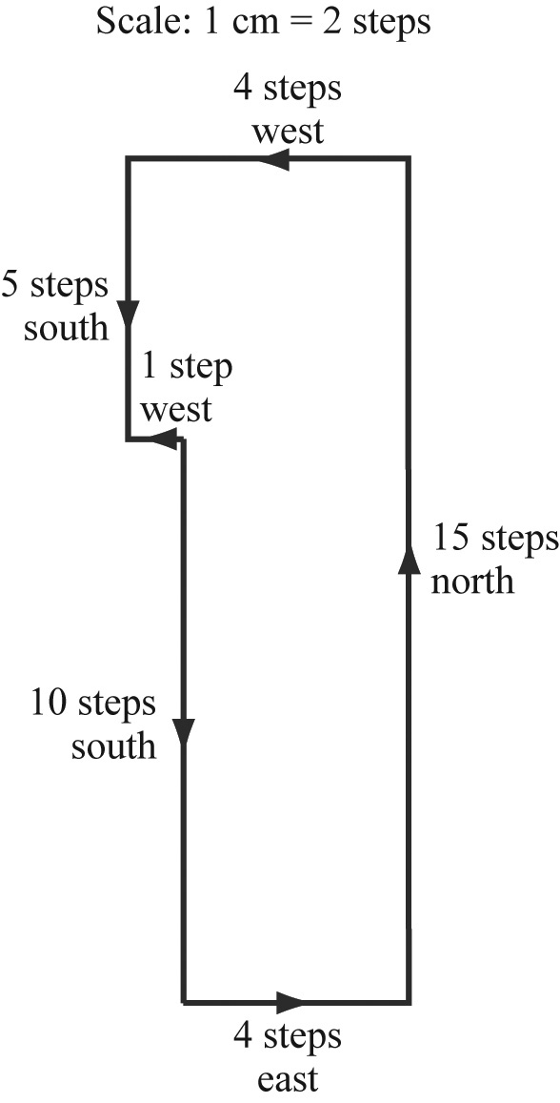
Example 7.1 e
Liam, aged 7, buried some ‘treasure’ in his backyard and wrote down these clues for you to find it: start at the clothes line, walk 10 steps south, then four steps east, 15 steps north, five steps west, and five steps south.
a) What distance (in steps) is travelled while tracing the ‘treasure’?
b) Where is the ‘treasure’ buried?
c) What is your displacement (in steps) as you follow the instructions?

Slide 10
When there is no acceleration
Speed is a measure of the rate at which an object moves over a distance. Because distance is a scalar quantity, speed is also a scalar quantity.
average speed = distance travelled
time interval
Velocity is a measure of the rate of displacement. Because displacement (change in position) is a vector quantity of an object, velocity is also a vector quantity.
average velocity = change in displacement
time interval

Slide 11
Example 7.1f
N
PHYSICS BUS
100 m
in 4 seconds
Distance travelled = ?
Displacement = ?
Speed = ?
Velocity = ?

Slide 12
Example 7.1g
James goes for a run. He jogs 120 m north in a time of 25 s, then turns and walks 40 m south in a further 20 s before stopping.
Calculate James’s average speed as he is jogging.
What is his average velocity as he is jogging?
What is the average speed for this 160 m exercise?
Determine the average velocity for this activity.
What is James’s average velocity for the last 25 s?
What is James’s average velocity in km h^{–1}?

Slide 13
Area Under the Line
Velocity: v_{av} = Δs
Δt
If we rearrange the equation, then;
Δs = v_{av} × Δt
Now we can find the displacement at any time interval using the area under the curve.
Velocity (m s⁻¹)
Time (s)
Example 7.1h: What is the displacement at 10 s?

Slide 14
Gradient of the Line
Velocity: v_{av} = Δs
Δt
Knowing
gradient (m) = rise
run
Now we can find the velocity.
Example 7.1i: Find the velocity?
Displacement (m)
Time (s)

Slide 15
Terminology
Instantaneous speed is the speed at a particular instant of time.
Instantaneous velocity is the velocity at a particular instant of time.

Slide 16
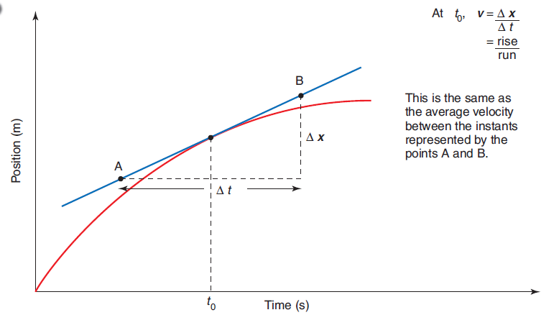
Displacement Graph
20
● W
11
2
6
Finding the instantaneous velocity on a curved displacement graphs.
At W:

Slide 17
Homework, Context & Keywords
Homework
Complete all questions from Set 7.1 - due first lesson next week.
Read Chapter 7.2, page 216-225 and answer
Q1 & Q2 Set 7.2
by next lesson.

Slide 18
Speed, Velocity and Acceleration
Chapter 7.2
Page 216 - 225

Slide 19
EQUATIONS OF MOTION
EQUATIONS OF MOTION
For UNIFORM ACCELERATION
SYMBOLS
a = acceleration (m s⁻²)
u = initial velocity (m s⁻¹)
v = final velocity (m s⁻¹)
s = displacement (m)
t = time taken (s)

Slide 20
Terminology Recap
Speed
v_{av} = Σs
Σt
Velocity
v_{av} = Δs = s_{f} - s_{i}
Δt t_{f} - t_{i}
This is when there is NO acceleration

Slide 21
Terminology
The rate at which an object changes its velocity is called its acceleration. Because velocity is a vector quantity, it follows that acceleration is also a vector quantity.
average acceleration = change in velocity
time interval
the change in velocity is (v_{final} – v_{initial})
Acceleration
a_{av} = Δv = v_{f} - v_{i}
Δt t_{f} - t_{i}

Slide 22
Example 7.2a
Determine the average acceleration of each of the following objects.
A car starting from rest reaches a velocity of 60 km h⁻¹ due north in 5.0 s.
A car travelling due west at a speed of 15 m s⁻¹ turns due north at a speed of 20 m s⁻¹. The change occurs in a time interval of 2.5 s.
A cyclist riding due north at 8.0 m s⁻¹ turns right to ride due east without changing speed in a time interval of 4.0 s.

Slide 23
Area and Gradient of the Line
Velocity (m s⁻¹)
Time (s)
Example 7.2b: Using the graph, find:
Acceleration
Displacement at 10 s
Displacement at 24 s

Slide 24
Area and Gradient of the Line
Velocity (m s⁻¹)
Time (s)
Example 7.2c: Using the graph, find:
Acceleration at 2 s
Acceleration at 8 s
Displacement at 4 s
Displacement at 10 s

Slide 25
Area Under the Line
Similarly with acceleration;
Δv = a_{av} × Δt
Acceleration (m s⁻²)
Time (s)
Example 7.2d: What is the velocity at 15 s?

Slide 26
What is this graph telling us
B
C
Velocity (m s⁻¹)
A
Time (s)

Slide 27
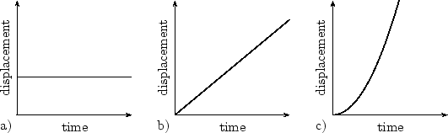
Displacement Graph
Standing still. At the beginning the object is x metres away from the origin and after some time the object is still x metres from the origin. It hasn’t moved.
Moving at a constant velocity. For every second that passes the same distance is covered.
Moving at an increased velocity. For every second that passes “double” that of the previous distance is covered.

Slide 28
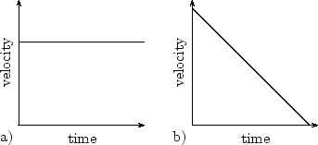
Velocity Graph

Slide 29
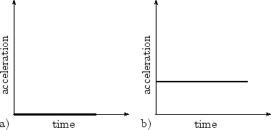
Acceleration Graph

Slide 30
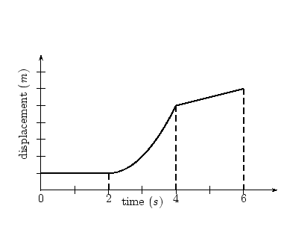
Displacement Graph
C
B
A

Slide 31
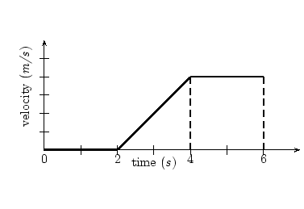
Velocity Graph
C
B
A

Slide 32
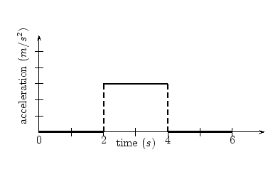
Acceleration Graph
B
A
C

Slide 33
Linking Graphs
C
All three graphs looked at are telling the same story, just from a different perspective.
Often the displacement graph is the most informative.
So recap.
Not moving
Accelerating
Constant velocity
B
A
C
B
A
B
A
C

Slide 34
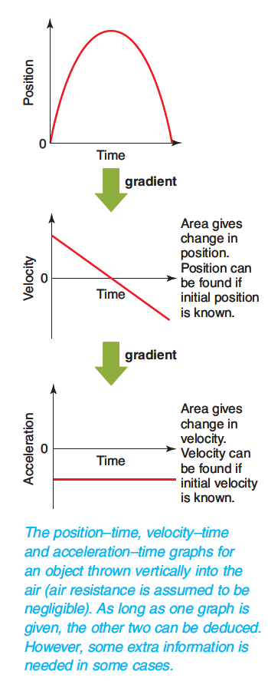
Linking Graphs
Describe these.

Slide 35
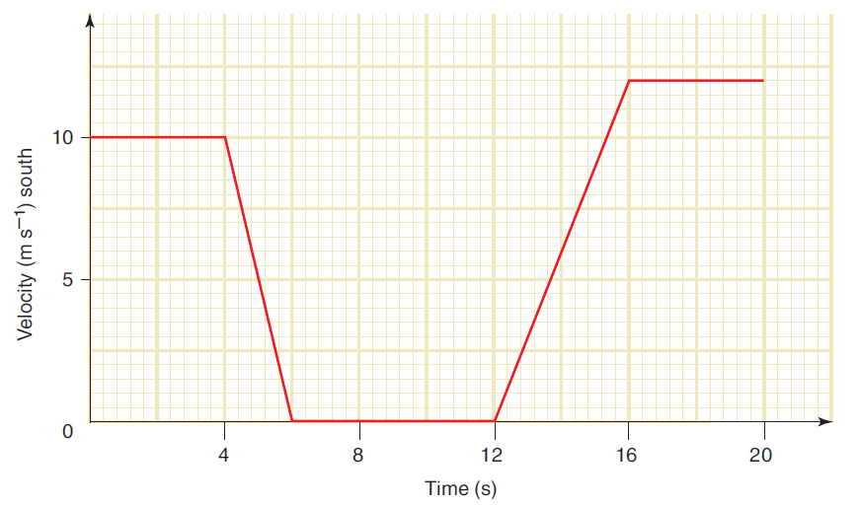
Example 7.2e
The velocity-time graph below describes the motion of a car as it travels due south through an intersection. The car was stationary for 6.0 s while the traffic lights were red.
(a) What was the displacement of the car during the interval in which it was slowing down?
(b) What was the average acceleration of the car during the first 4.0 s after the
lights turned
green?
(c) Determine the
average velocity
of the car during
the interval
described by the
graph.

Slide 36
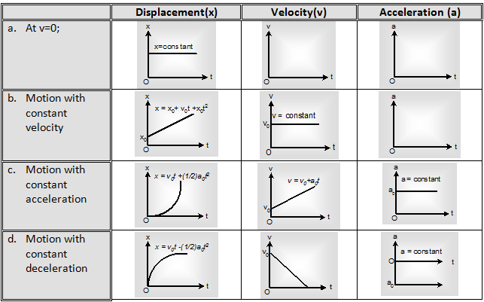
The Four Combinations

Slide 37
Example 7.2f
B
A
C
Distance (m)
Sketch a velocity versus time graph.
Sketch an acceleration versus time graph.

Slide 38
a) Sketching Velocity versus Time
Velocity (m s⁻¹)
Time (s)

Slide 39
b) Sketching Acceleration versus Time
Acceleration (m s⁻²)
Time (s)

Slide 40
Distance (m)
Velocity (m s⁻¹)
Acceleration (m s⁻²)
Time (s)

Slide 41
Homework, Context & Keywords
Homework
Complete all questions from Set 7.2 - due first lesson next week.
Read Chapter 7.3, page 226-237 and answer
Q1,2 Set 7.3
by next lesson.

Slide 42
Equations of Motion
Chapter 7.3
Page 226 - 237

Slide 43
Equations of Motion
When acceleration is zero (a = 0)
v = s
t
When acceleration is not zero (a ≠ 0)
v = u + a t
s = u t + ½ a t²
v² = u² + 2 a s

Slide 44
USING THE EQUATIONS OF MOTION
v = u + a t
s = u t + ½ a t²
v² = u² + 2 a s
1. Write down the parameters that you know and include the vector direction for each.
2. Write down the symbol of the quantity that you require.
3. Select the equation that contains all of the symbols in step 1. and 2. above.

Slide 45
Example 7.3a
A snowboarder in a race is travelling at 10 m s^{–1} as she crosses the finishing line. She then decelerates uniformly until coming to rest over a distance of 20 m.
a) What is her acceleration as she pulls up?
b) How long does she take to come to rest?
c) Calculate the average speed of the snowboarder as she pulls up.

Slide 46
Example 7.3b
A car starts from rest and accelerates uniformly for 8.0 s. It reaches a final speed of 16 m s^{–1}.
a) What is the acceleration of the car?
b) Calculate the distance travelled by the car.
c) What is the average velocity of the car?

Slide 47
Example 7.3c
A book is knocked off a bench and falls vertically to the floor. If the book takes 1.0 s to fall to the floor, calculate:
a) its speed as it lands
b) the height from which it fell
c) the distance it falls during the first 0.5 s
d) the distance it falls during the final 0.5 s.

Slide 48
Example 7.3d
A new model BMW can start from rest and travel 400 m in 16 s.
a) What is its average acceleration during this time?
b) Calculate the final speed of the car.
c) How fast is this final speed in km h^{–1}?

Slide 49
Example 7.3e
John throws a ball in the air at a velocity of 6 m s⁻¹ and then catches it in the same position he threw it from. Calculate;
a) The time it took from the moment it left his hand until it returned.
b) The maximum height

Slide 50
Example 7.3f
Sandra throws a rock down a cliff with a velocity of 15 m s⁻¹ and then times how long it takes before she sees it hit the bottom (cloud of dust). If it took 5.29 s to hit the base, calculate the height of the cliff.

Slide 51
Example 7.3g
In class Henry notices a piece of Velcro stuck, face down on the ceiling. He decides he is going to throw his tennis ball at it, so it sticks. If he throws it too hard the force of impact will cause it to rebound and not stay in position and if he throws it too soft then the ball wont reach the ceiling. Make assumptions and calculate at what velocity he needs to release the ball in order to have the ball just touch the Velcro and stick.

Slide 52
Homework, Context & Keywords
Homework
Complete all questions from Set 7.3 - due first lesson next week.
Read Chapter 8.1, page 242-246 and answer
Q1,2 Set 8.1
by next lesson.

